Slide 1

NODEJS Login And Registration with MYSQL
-Akshit Saini

Slide 2
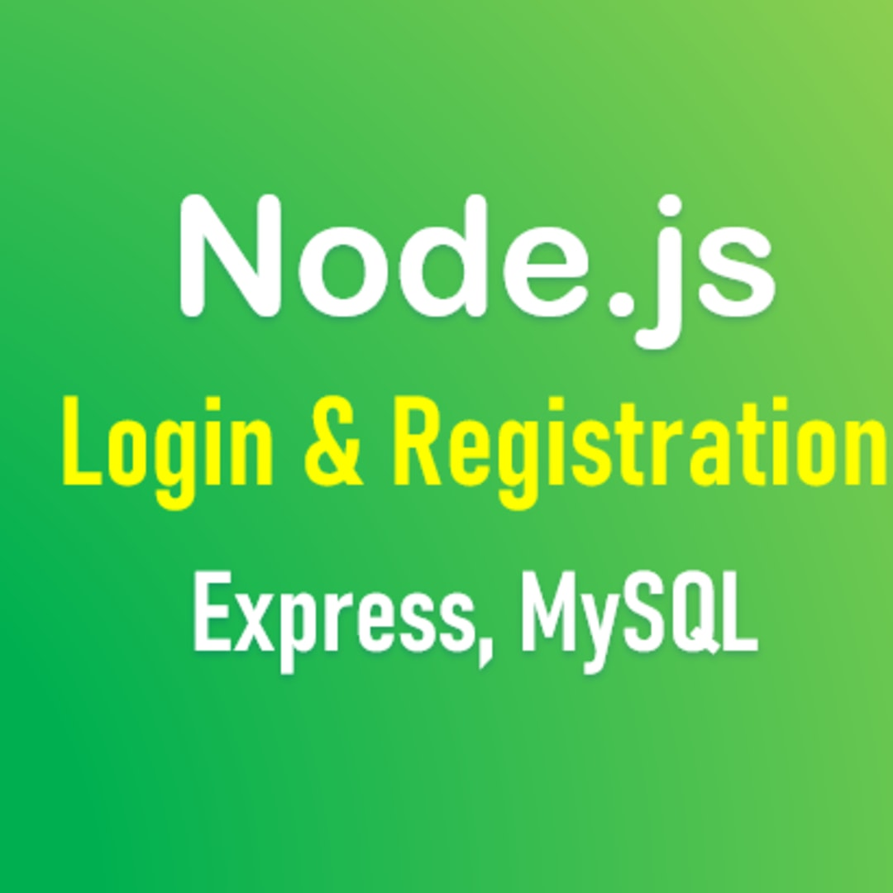

NODEJS AND MYSQL
Nodejs and MySQL are some of the necessary binding needed for any web application. As a cross-platform runtime environment, Node.js enables web programmers to build a variety of server-side applications using JavaScript .
As the JavaScript applications run within the Nodejs runtime, they can run seamlessly on major operating systems and web servers. Thus, the open source runtime environment helps developers to make web applications more responsive by writing both client-side and server-side code in JavaScript.
Node.js is a backend technology used to implement server-side business logic and MYSQL works perfectly as a Database along with it.
.

Slide 3
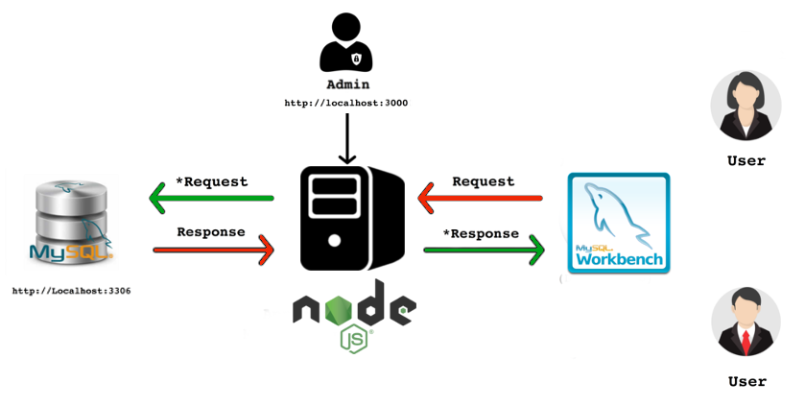
NODEJS AND MYSQL
To access a MySQL database in Node.js, you need a MySQL driver:
C:\Users\PROJECT NAME>npm install mysql
Node.js uses the following module to reach out the Database:
var mysql = require('mysql’);

Slide 4
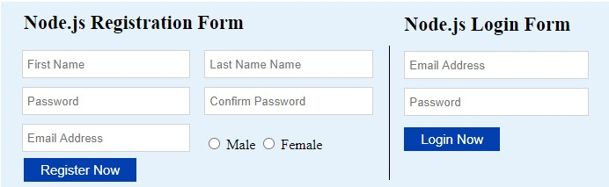
LOGIN AND REGISTRATION PAGE
FOLLOWING STEPS ARE USED TO CREATE THE LOGIN PAGE
Creating Database
Inserting Data in Database.
Connect your NodeJS with MYSQL using given commands
Setup Nodejs and Routes
Enter the login information and confirm

Slide 5
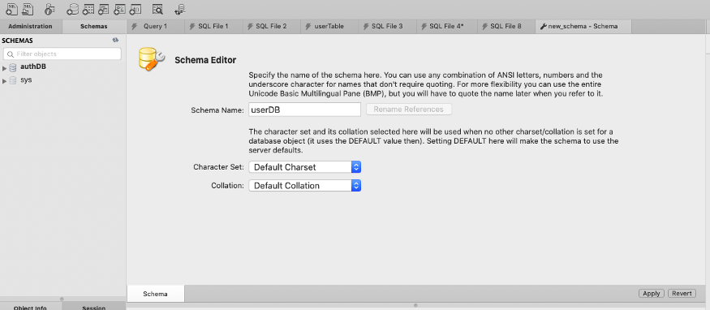
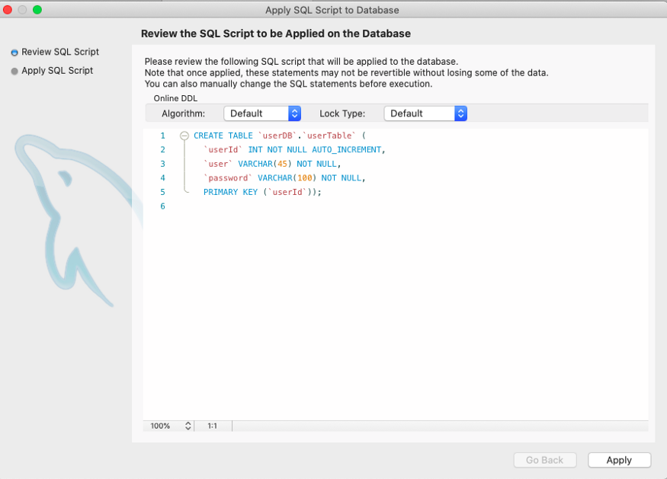
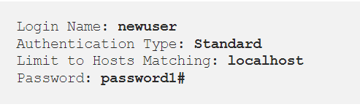
Creating a Database
Create a new Database in MYSQL-Workbench
Create a table in the database and add the credentials user-id, user and password.
Following information will be used in our Nodejs code to connect to the database.

Slide 6
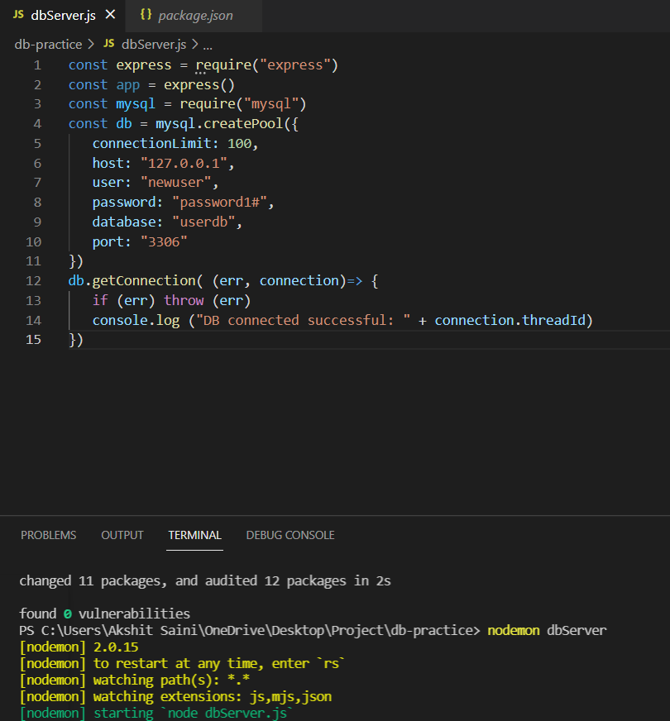
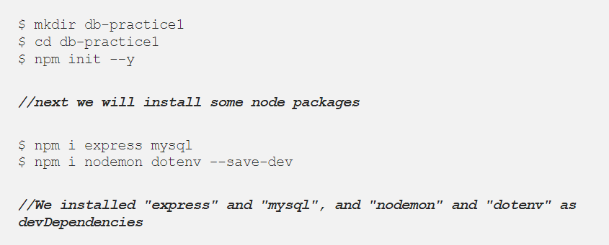
Connecting NodeJS App with MYSQL Database
1

Slide 7
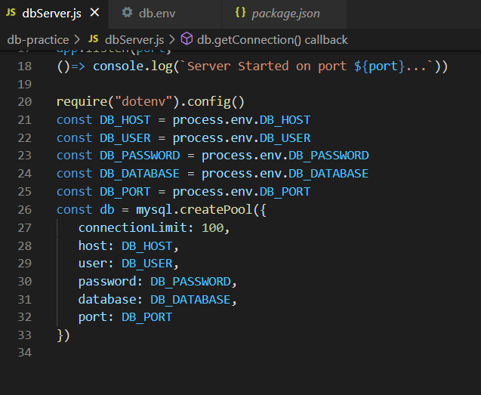
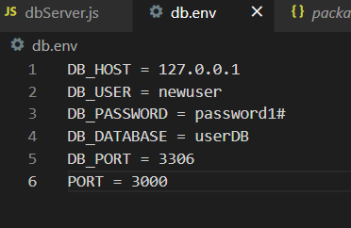
CREATING .env FILE TO IMPORT CREDENTIALS
Importing .env FILE TO our NODEJS file

Slide 8
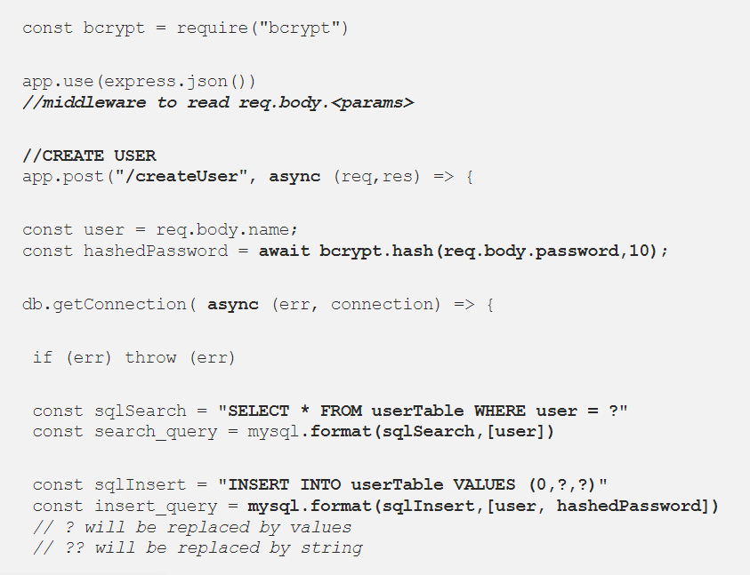

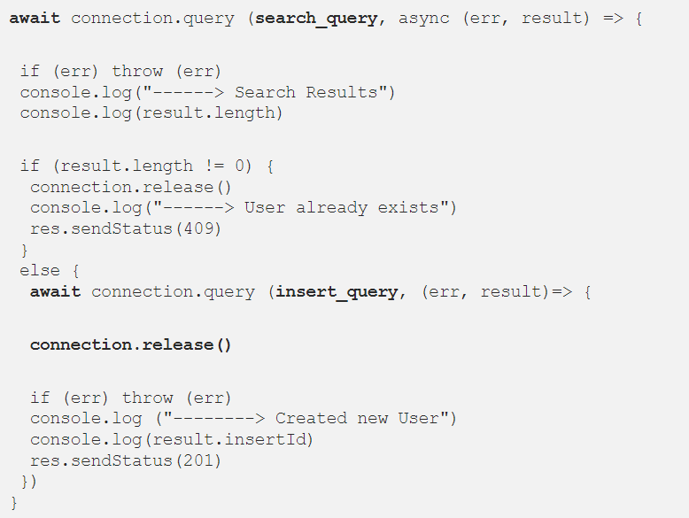
REGISTRATING A NEW USER
We will create routes to register a new user in our database.
We will be using bcrypt to store hashed passwords in our Database.
The bcrypt function may take a while to generate the hash, and so we use the "await" keyword in front of it. Since we are using the "await" keyword within the function, we need to add "async" keyword in front of the function. "async" and "await" are basically "syntactical sugar", or a neater way to write promises in Javascript.

Slide 9
THANK-YOU

